Slide 1
Low Income Multi-Family
Housing Automation
Ben Seiber, Thomas Pionk, Jheryl Lezama, Jeff Wallace, Daniel Wilmot
Notes:
Ben’s slide - Introductions

Slide 2
Sprint 5 - Contributions
Ben Seiber
Fabricated logic circuits for Utility control and emergency water shut-off; fabricated and coded final model control aspects geared towards final presentation.
Began integration between Arduino and Raspberry Pi using serial and I2C.
Created water emergency control physical model; integrated with electricity and H₂0 (yikes).
Thomas Pionk
DHT22 Temperature and Humidity sensor implementation. (two of these)
Helped fabricate and wire the model for presentations.
Jheryl Lezama
Documentation: Updated Test Cases, RMM Matrix, State Diagram and Data structures.
Risk Mitigation: Researched and formulated various risk mitigation plans moving forward with system integration (added to RMM Matrix).
Jeff Wallace
Documentation: MySQL database structures, entity relation diagram, user scenarios, research.
Database: Integration with Raspberry Pi, improving tables and schemas.
Migrated website from Wamp server to Lamp server on Raspberry Pi.
Daniel Wilmot
Finalized dynamic property homepage. (Ajax, Database, PHP).
Research: AJAX, PHP, JSON, JQuery for setting up property management.
Group Effort
Converting the web dev Wamp server to a Lamp server and integrated it with our sensors database.
Notes:
Everyone

Slide 3
Sprint 5 - What we Completed
Emergency/Catastrophic control of physical environment (logical cause and effect).
Completed physical model for final presentation (structure, presentation controls, wiring).
Migration of website to Raspberry Pi via the Wamp to Lamp conversion.
Updated property management screen.
Notes:
Jeff

Slide 4
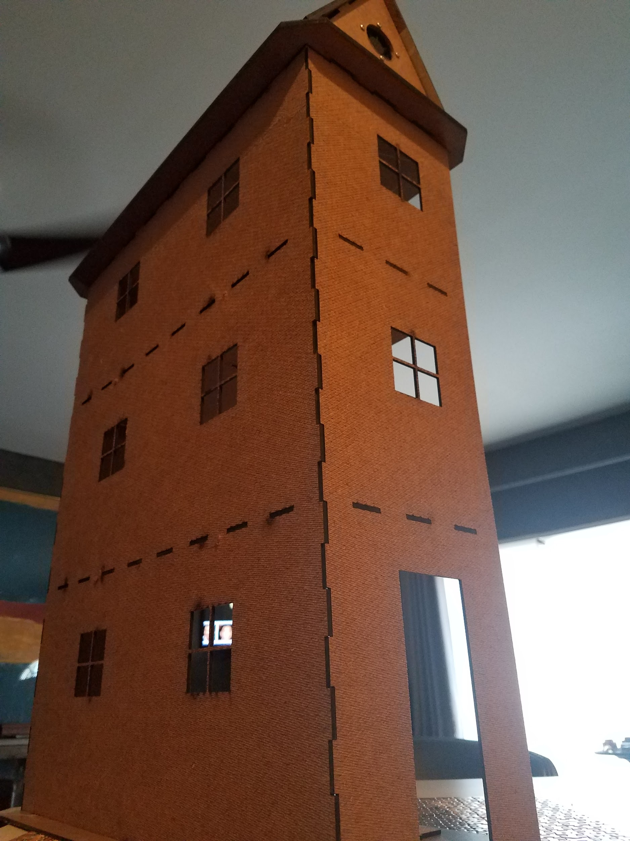
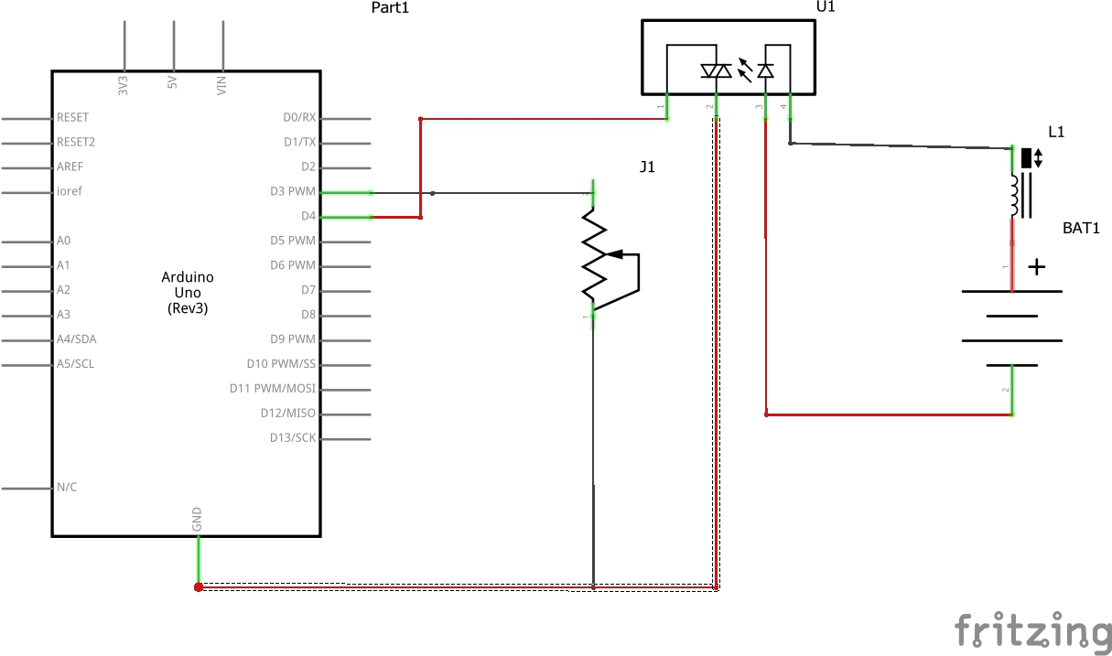
Utility Electrical & Physical Model
Emergency Water Shut-Off Sensor and Control
Physical Model - Pre-finish
Notes:
Ben

Slide 5
Goals for Sprint 6
Insert the functionality for generating cost-saving analytics.
Final revisions for the website application.
Have final display model at “presentation level” including all sensors installed, mounted and functioning.
Notes:
Dan

Slide 6
Demo
Notes:
Danny and Ben demos

